Slide 1
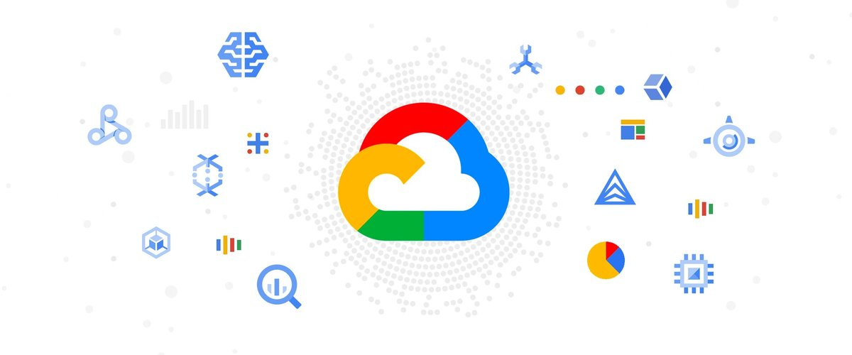

COURSE INSTRUCTOR: MAHALAKSHMI B S, ASST.PROFESSOR, DEPT OF ISE, BMSCE
BY: K PREM KUMAR(1BM19IS066)
MADHUSUDHAN(1BM19IS082)
JAYANTH KUMAR(1BM19IS065)

Slide 2
CONTENT
BIG QUERY
BLOCKCHAIN
AUTOMATED APPLICATION DEPLOYMENT TO KUBERNETES ON GOOGLE CLOUD PLATFORM
IMPLEMENTATION OF KUBERNETES
Security and compliance
CLOUD COMPUTING IN CEP

Slide 3
Google Cloud Platform
WHAT IS GOOGLE CLOUD PLATFORM?
The Google Cloud Platform is also known as GCP. The Google cloud platform is a product of Google. It is a platform which provides cloud services to the users. To look at the operation of the Google cloud platform, this platform works on the same architecture on which other products of Google work; for example, YouTube and Google.
The services which are provided by this platform are data storage, data analytics, machine learning, computing, etc. The Google cloud platform is written in Java, C++, Go, Ruby and Python programming language. People can register themselves on this platform by using their bank account details and credit card as well. The Google cloud platform provides three types of computing environments. These are Infrastructure as a service, server-less computing, and platform as a service. These environments are also known as Iaas, Saas and Paas.
what’s new in gcp-API security—Google Cloud Apigee API management platform's latest release, Apigee X, works with Cloud Armor to protect your APIs with advanced security technology including DDoS protection, geo-fencing, OAuth, and API keys.

Slide 4
Big query
Storing and querying massive datasets can be time consuming and expensive without the right hardware and infrastructure. BigQuery is an enterprise data warehouse that solves this problem by enabling super-fast SQL queries using the processing power of Google's infrastructure. Simply move your data into BigQuery and let us handle the hard work. You can control access to both the project and your data based on your business needs, such as giving others the ability to view or query your data.
You can access BigQuery by using the Cloud Console, by using the bq command-line tool, or by making calls to the BigQuery REST API using a variety of client libraries such as Java, .NET, or Python. There are also a variety of third-party tools that you can use to interact with BigQuery, such as visualizing the data or loading the data.
BigQuery is fully-managed. To get started, you don't need to deploy any resources, such as disks and virtual machines.

Slide 5
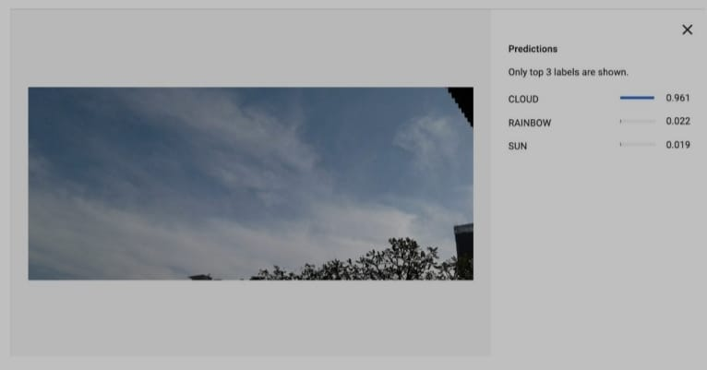
Weather forecast with vision API and Image Processing
The observational data on its own tells you what
happened at a specific location in the past,
weather model data can be interpolated
to give you a forecast for any location.
These forecast data can significantly
deviate from the truth on the ground.
Weather models on their own typically struggle in topographically challenging environments, for example in alpine regions, where the difference between actual elevation and the modelled elevation can be significant, which impacts the quality of the forecasted parameters.
To overcome these challenges Meteomatics brings together a proven interpolation technique, the most recent observational data taken from weather stations, satellite images, and radar and combines these with model data that has already been snapped to NASA’s 90m digital terrain model. In this way we can deliver a highly accurate forecast for any location.
As Meteomatics API requests are not precomputed when you query for weather data, you always receive the most recently updated forecast data.

Slide 6
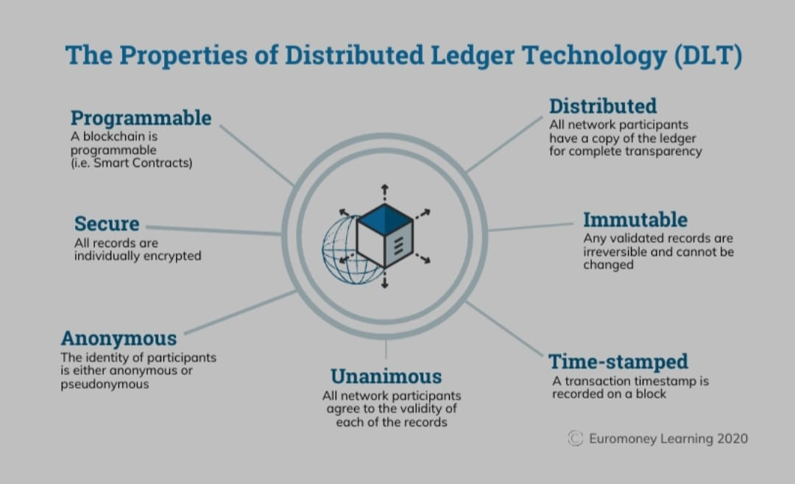
BLOCKCHAIN-
Blockchain is a system of recording information in a way that makes it difficult or impossible to change, hack, or cheat the system.
A blockchain is essentially a digital ledger of transactions that is duplicated and distributed across the entire network of computer systems on the blockchain. Each block in the chain contains a number of transactions, and every time a new transaction occurs on the blockchain, a record of that transaction is added to every participant’s ledger. The decentralised database managed by multiple participants is known as Distributed Ledger Technology (DLT).
Blockchain is a type of DLT in which transactions are recorded with an immutable cryptographic signature called a hash.

Slide 7
There are three reasons why you need to know about Blockchain:
Blockchain technology doesn't have to exist publicly. It can also exist privately where nodes are simply points in a private network and the Blockchain acts similarly to a distributed ledger. Financial institutions specifically are under tremendous pressure to demonstrate regulatory compliance and many are now moving ahead with Blockchain implementations. Secure solutions like Blockchain can be a crucial building block to reduce compliance costs.
Block-chain technology is broader than finance. It can be applied to any multi-step transaction where traceability and visibility is required. Supply chain is a notable use case where Blockchain can be leveraged to manage and sign contracts and audit product provenance. It could also be leveraged for votation platforms, titles and deed management - amongst myriad other uses. As the digital and physical worlds converge, the practical applications of Blockchain will only grow.
The exponential and disruptive growth of Blockchain will come from the convergence of public and private Blockchains to an ecosystem where firms, customers and suppliers can collaborate in a secure, auditable and virtual way.
FEATURES:Immutability,Decentralized,Faster Settlement,Enhanced Security,Distributed Ledgers,Consensus

Slide 8
AUTOMATED APPLICATION DEPLOYMENT TO KUBERNETES ON GOOGLE CLOUD PLATFORM
Introduction:
Google has been active and strategic in their growth and target customer space. Leveraging their experience in Kubernetes and coordinating large and reliable infrastructure systems, Google offers a Kubernetes managed service as a top-of-the-line selection for deploying microservices applications. Along with their obvious strength in Kubernetes, Google also offers plenty of developer tools as a service, raising the quality of life for customers opting for a full cloud native experience on Google Cloud Platform.
Kubernetes is a portable, extensible, open-source platform for managing containerized workloads and services, that facilitates both declarative configuration and automation ,letting you run distributed systems resiliently, with scaling and failover for your application
THEORY:
This part of the thesis explains the technical theory behind the pipeline design and the services and applications used in order to achieve the goal of building a model automated delivery pipeline.
Microservices architecture:
development teams have adopted a more loosely coupled architecture that promotes the decoupling of different components within a monolithic server and turn them into collaborating modules called services
Containerization:
The main difference between Containers and VMs is that each VM runs its own OS under the Hypervisor while Containers share the host OS and runs under the container engine layer

Slide 9
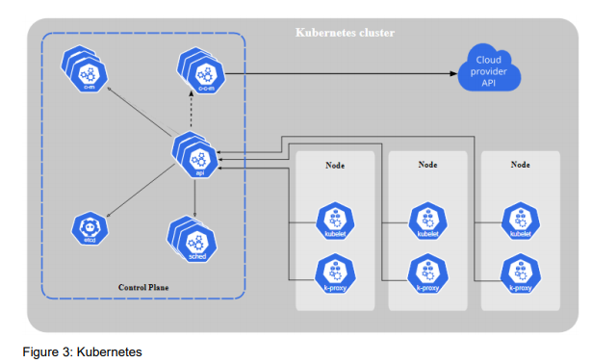
Some benefits of containerization include:
Efficiency
Portability
Security
Kubernetes:
Managing all these container by container would be a very tall task. With this problem in mind, some engineers at Google started an open-sourced project called Kubernetes that aims to solve these issues and bring the idea of containerization closer to being a common reality. Since then, Kubernetes has grown into a highly scalable and reliable container orchestration platform that also provides a multitude of support services that greatly enhances the experience of using containers. According to “The State of Kubernetes 2020” report by VMWare, 59% of respondents were using Kubernetes in their production environment, and over 95% of respondents said that they see a clear benefit in Kubernetes adoption .
Kubernetes components:
In order to manage so many additional services, Kubernetes introduces a few concepts to provide a centralized platform

Slide 10
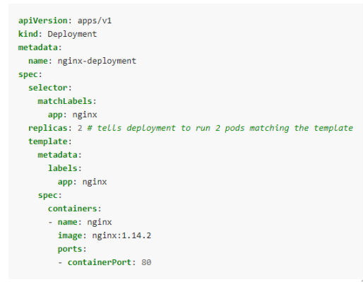
Kubernetes objects:
apiVersion: the version of the Kubernetes API that the user wants to use for this object.
kind: which type of object does the user want to create.
metadata: data that helps in identifying an object, such as name, uid, namespace and label.
spec: the desired state of the object.
Google Kubernetes Engine:
Google Kubernetes Engine is GKE’s managed Kubernetes service on GCP. By managed service, Google means that the provision, creation and management of sufficient infrastructure would be Google’s responsibility and customers only need to focus on the application and products that they would be running on top of the provisioned resources. Google makes sure that the resources provisioned would be guaranteed to function properly with an SLA for each managed service product. The GKE environment consists of multiple machines grouped together to form a cluster. By offloading the management of the control plane to GKE, developers eliminate the high overhead of setting up management components like the scheduler or the api server, as well as the need for setting up utilities such as autoscaling, auto-healing and OS image management, to name a few. Previously the management overhead for running a Kubernetes cluster has been a significant problem. There are so many problems that needed to be addressed and so many detailed components that could raise a conflict. To name a few, problems might arise when creating master node replicas, bootstrapping a high availability etcd storage cluster or configuring remote access with role-based access control. Furthermore, GKE has strong integration with other GCP services such as load balancing or centralized monitoring, which immensely simplify the operation and deployment process for companies.

Slide 11
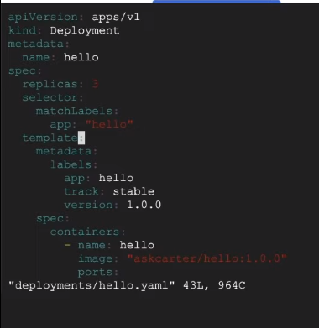
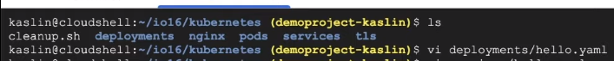
Cloud Source Repository and Container Registry : Each project on GCP has its own Cloud Source Repository and CSR can also integrate with both Github and Bitbucket. To Google, CSR is more like an extension to GCP rather than a direct opponent to Github or Bitbucket.
Container Registry: is GCP’s repository for Container Images. More than just an Image repository, the Container Registry also provides additional services like build automation for Cloud Build or direct deployment to GKE, App Engine, Cloud Function or Firebase.
Cloud build:
In order to run Cloud Build, users can write a build config file to provide Cloud Build with instruction on what task to perform. Users can configure builds to fetch dependencies, run tests, analysis and create artifacts with tools such as docker, gradle, maven, bazel and gulp. Cloud Build executes this config as a series of build steps, where each step is run inside a Docker container. Executing build step is largely similar to executing commands in a script.
IMPLEMENTATION :

Slide 12
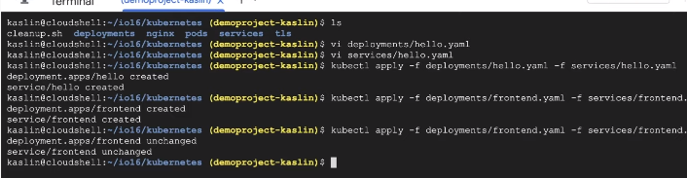
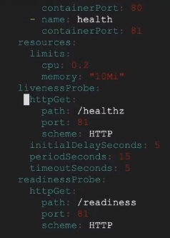
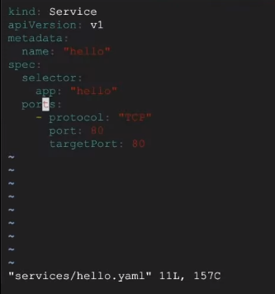
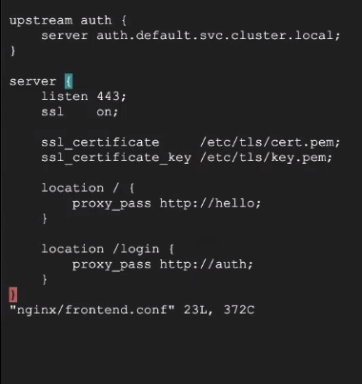

Slide 13
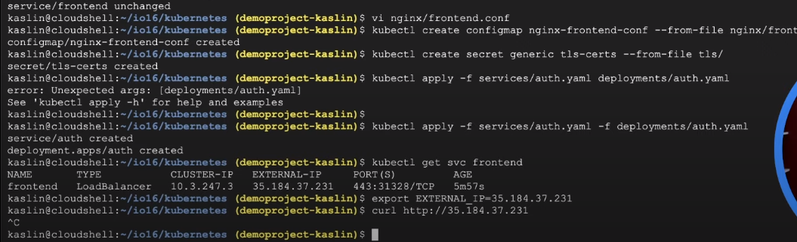
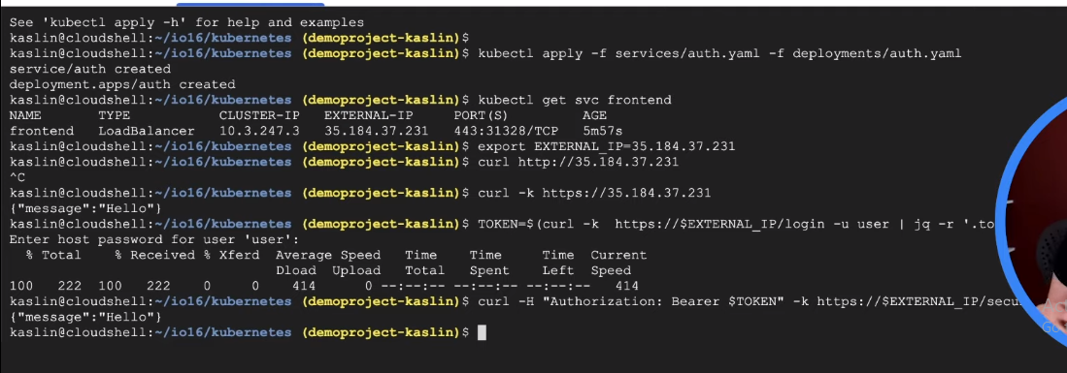

Slide 14
Security and compliance
Introduction:
the growth of the cloud has thrust the issue of security and trust into the spotlight. that’s because cloud services operate very differently from traditional on-premises technology. rather than residing on local servers, content is now managed on google servers that are part of our global data center network. in the past, organizations felt that they had complete control over how infrastructure was run and who operated it. organizations moving to the cloud will rely on cloud suppliers to manage the infrastructure, operations, and delivery of services.
google fully understands the security implications of the cloud model. our cloud services are designed to deliver better security than many traditional on-premises solutions.

Slide 15
GOOGLE HAS A STRONG SECURITY CULTURE
google has created a vibrant and inclusive security culture for all employees. the influence of this culture is apparent during the hiring process, employee onboarding, as part of ongoing training and in company-wide events to raise awareness.
Technology with Security at Its Core
g suite runs on a technology platform that is conceived, designed and built to operate securely. google is an innovator in hardware, software, network and system management technologies

Slide 16
Regulatory Compliance
google takes a global approach to our commitments on data processing. google operate in a global environment. g suite offers a data processing amendment and eu model contract clauses to facilitate compliance with jurisdictional-specific laws or regulations. your organization can opt into our data processing amendment by following the instructions in our help center.

Slide 17
CLOUD COMPUTING IN CEP
internet of things (ioT) has posed new requirements to the underlying processing architecture, specially for real-time applications, such as event-detection services. complex event processing (cep) engines provide a powerful tool to implement these services. fog computing has raised as a solution to support ioT real-time applications, in contrast to the cloud-based approach. this work is aimed at analysing a cep-based fog architecture for real-time ioT applications that uses a publish-subscribe protocol. a testbed has been developed with low-cost and local resources to verify the suitability of cep-engines to low-cost computing resources. to assess performance we have analysed the effectiveness and cost of the proposal in terms of latency and resource usage, respectively

Slide 18
Results show that the fog computing architecture reduces event-detection latencies up to 35%, while the available computing resources are being used more efficiently, when compared to a cloud deployment. performance evaluation also identifies the communication between the cep-engine and the final users as the most time consuming component of latency. moreover, the latency analysis concludes that the time required by cep-engine is related to the compute resources, but is nonlinear dependent of the number of things connected. keywords: fog computing, cloud computing, edge computing, complex event processing, real-time iot applications, benchmark analysis.

Slide 19

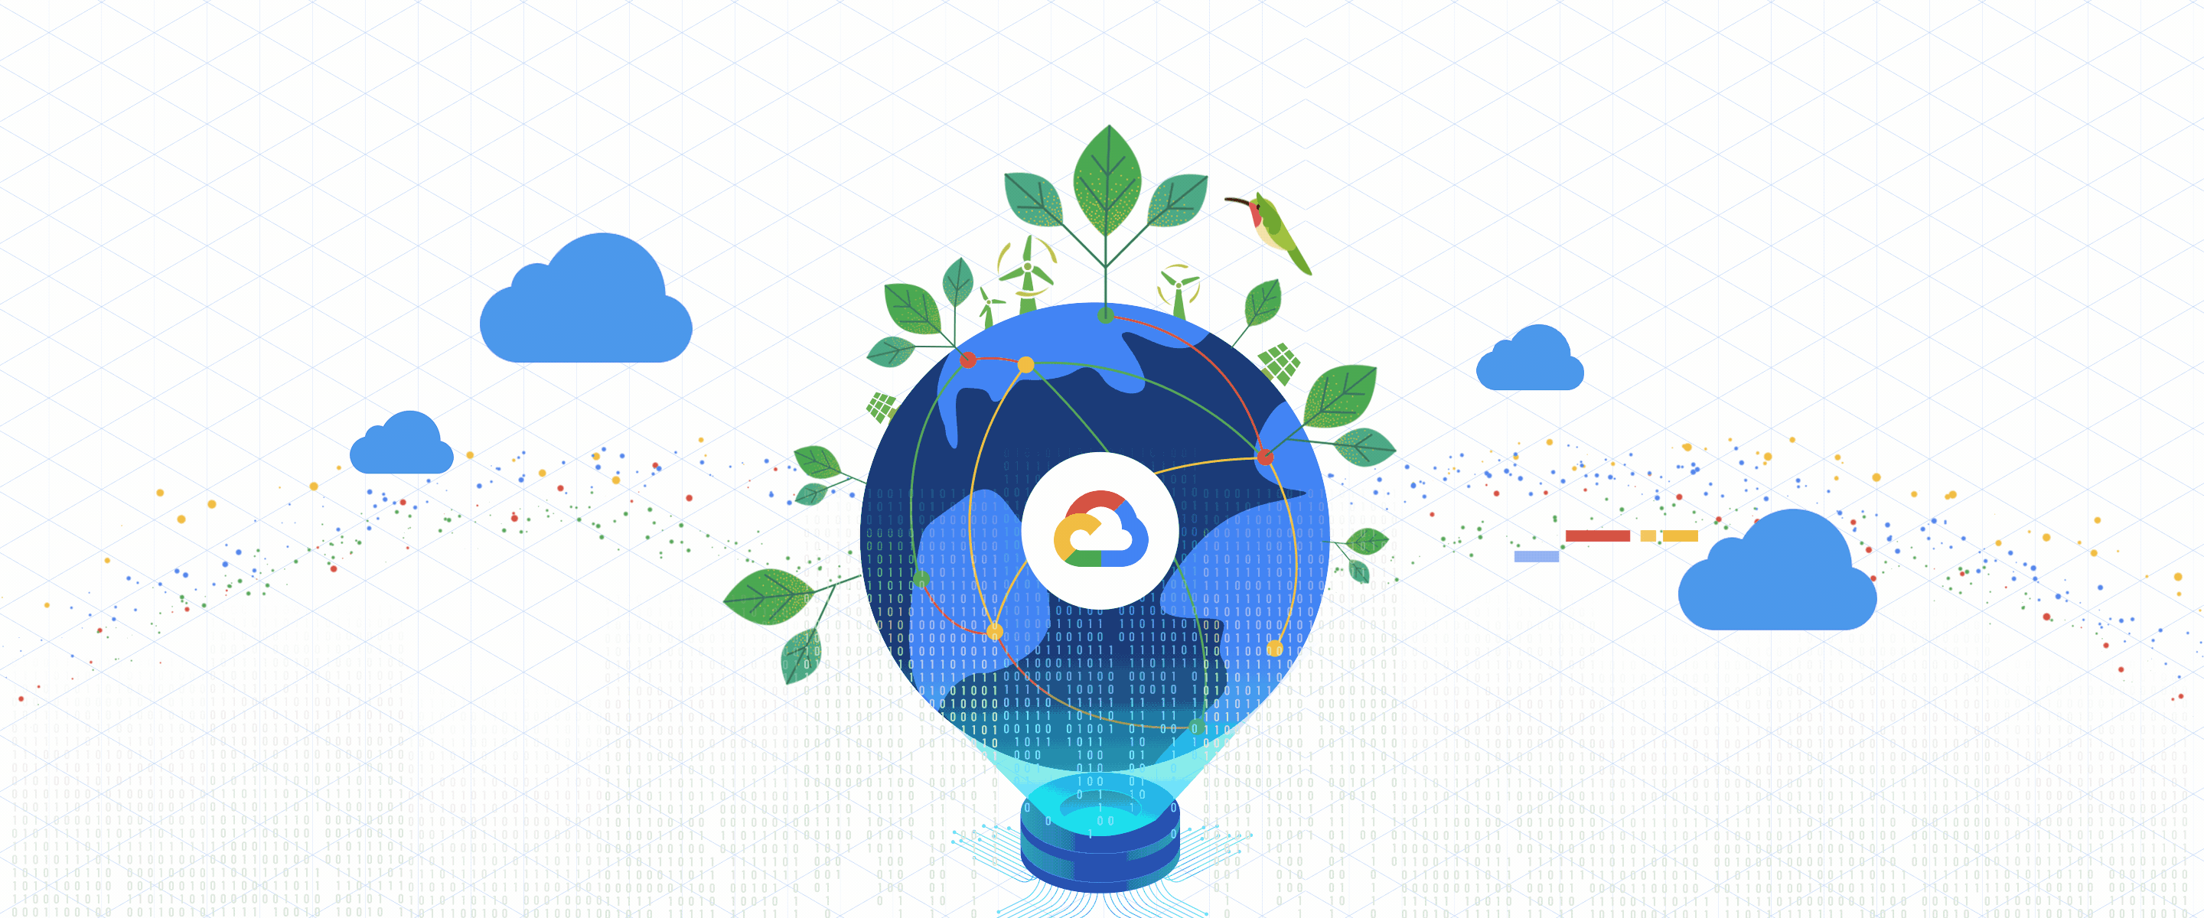
FACT
“GOOGLE CLOUD IS THE CLEANEST CLOUD AS IT IS NET CARBON –NEUTRAL CLOUD AS ELECTRICITY USED IS MATCHED IS 100% WITH RENEWABLE ENERGY”

